Slide 1
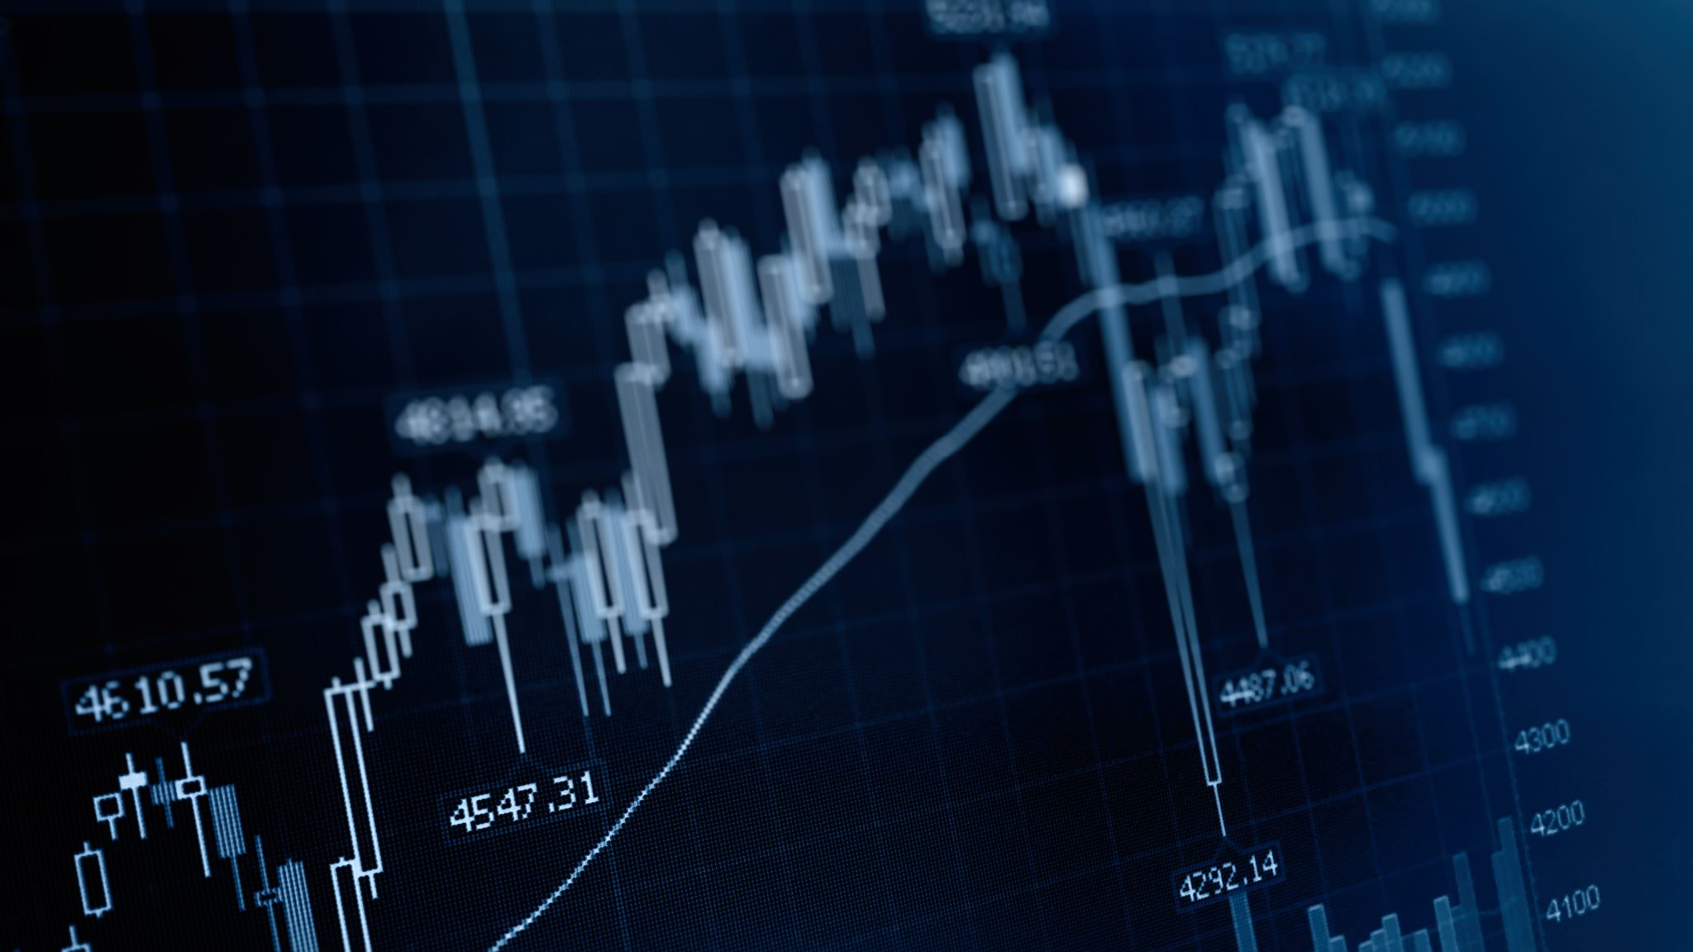
Using Price Data to Predict Stock Market Prices
Sabancı University Data Analytics Program Term Project
Duruhan Yalçın

Slide 2
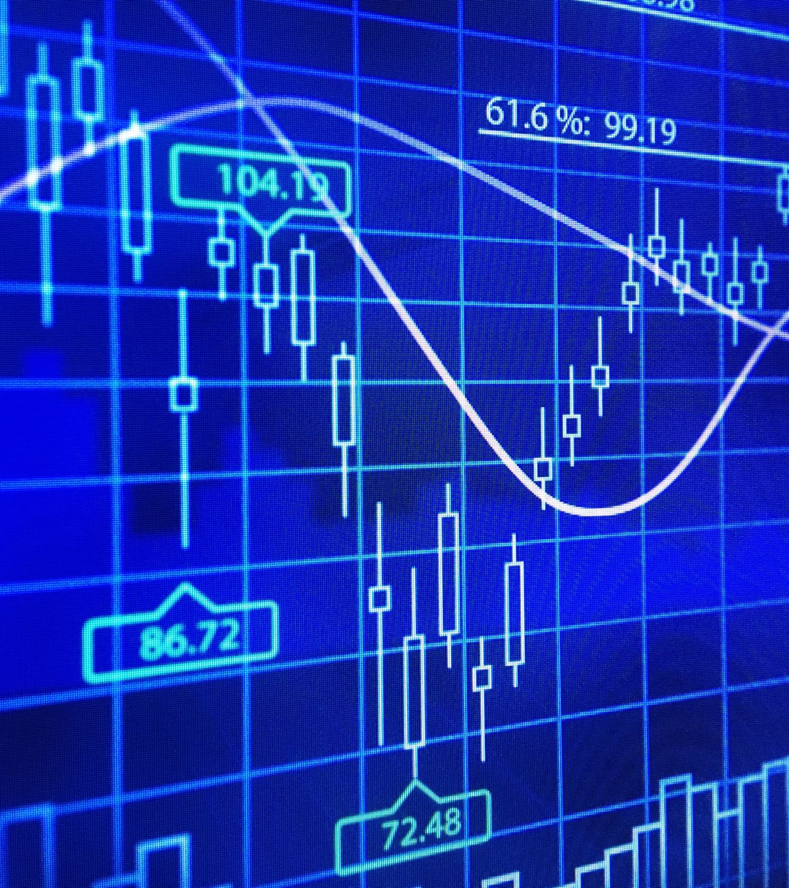
Exploratory Data Analysis on NASDAQ

Slide 3
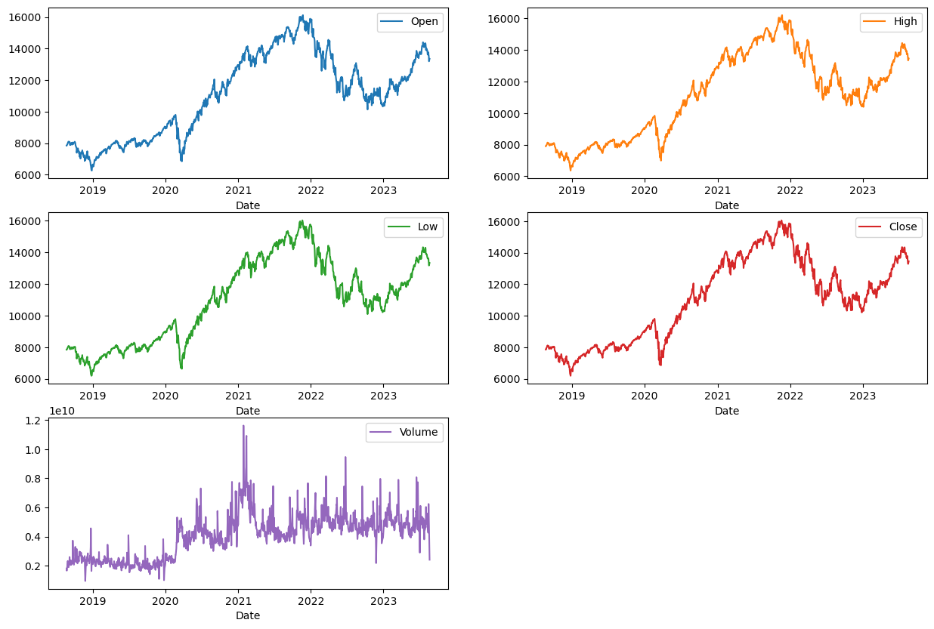
Initial Features Price and Volume

Slide 4

The Time Factor: Understanding Price Volatility

Slide 5
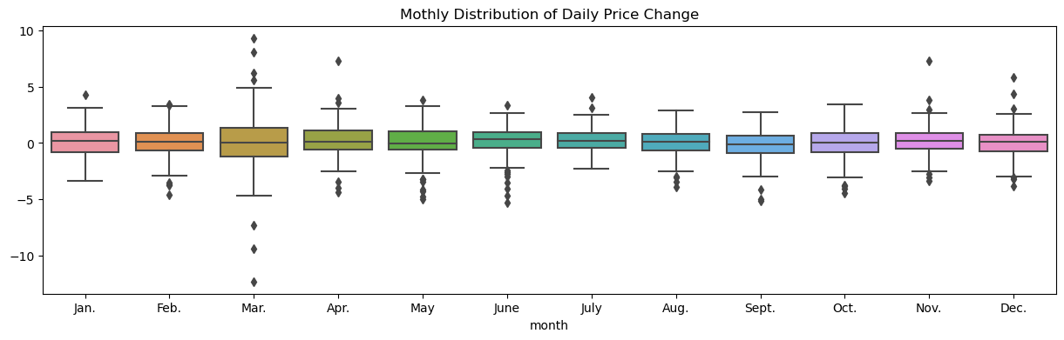

Slide 6
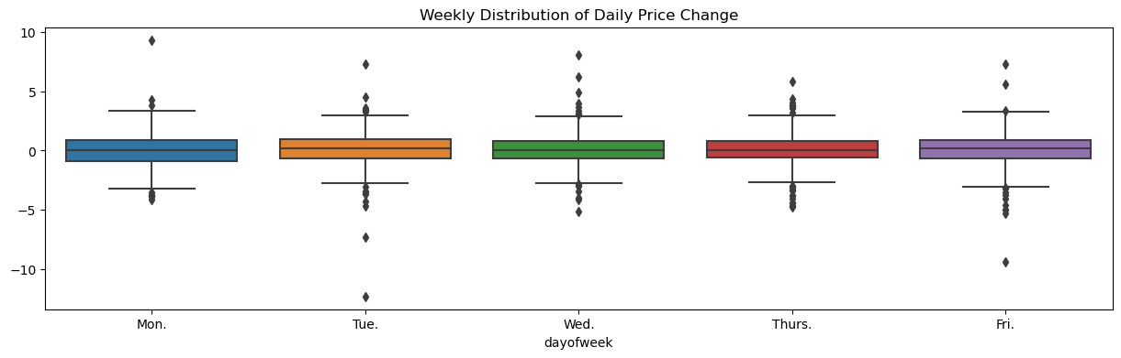

Slide 7
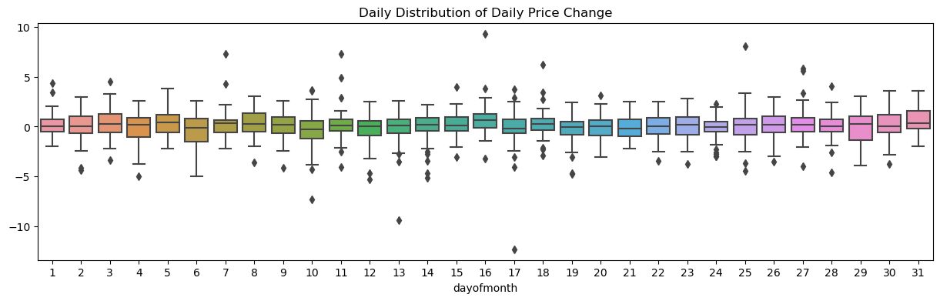

Slide 8
Understanding Volume Variability Through Time

Slide 9
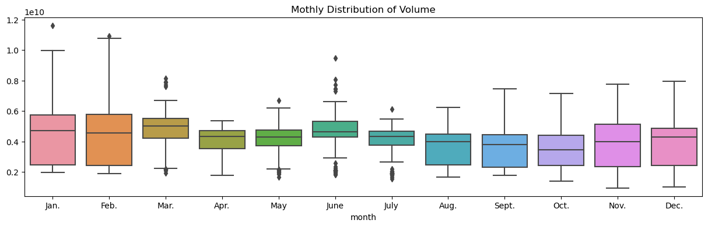

Slide 10
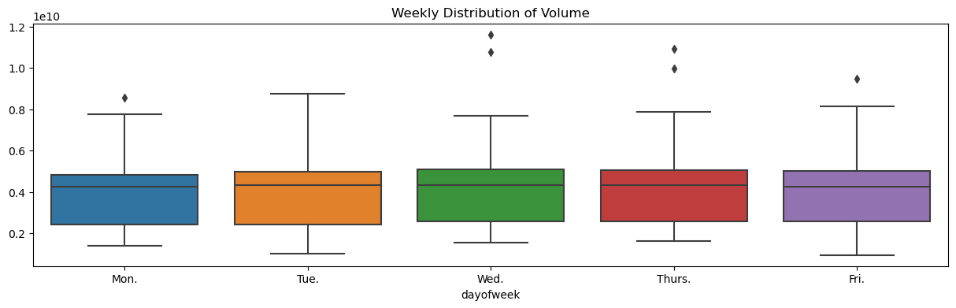

Slide 11
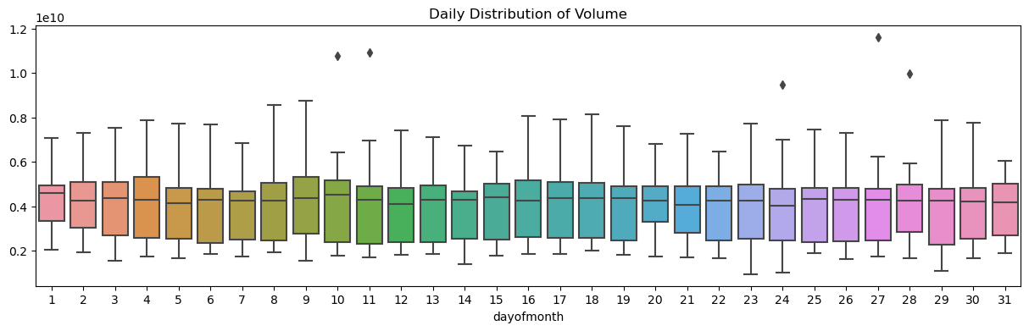

Slide 12
Data Preprocessing

Slide 13
Feature Generation

Slide 14
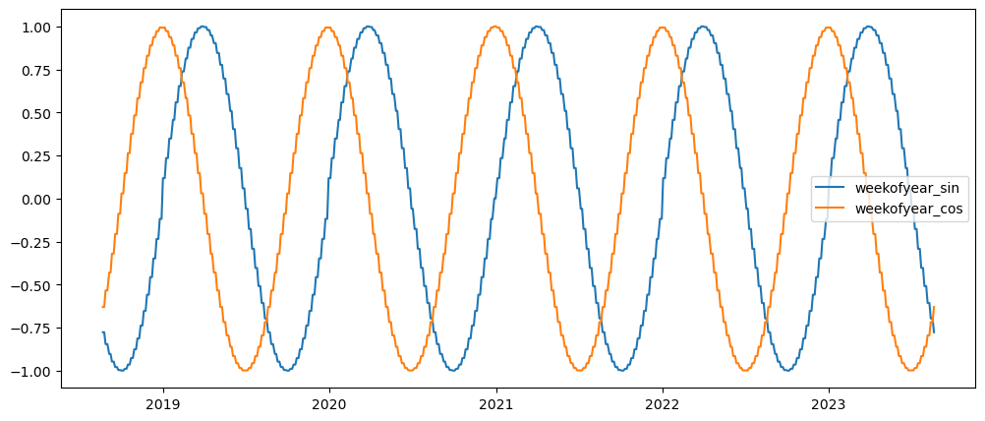
Time Related Features Day of Week and Week of Year

Slide 15
Technical Indicators
SMA (Simple Moving Average)
RSI (Relative Strength Index)
Momentum
Stochastic Oscillator
MACD (Moving Average Convergence Divergence)
ATR (Average True Range)
OBV (On-Balance Volume)
Bollinger Bands

Slide 16
Indices, Cryptocurrencies and Commodities
BTC-USD: Bitcoin against the US Dollar
^VIX: CBOE Volatility Index, also known as the "fear index".
^DJI: Dow Jones Industrial Average
^GSPC: S&P 500 Index
^FTSE: FTSE 100 Index
^GDAXI: DAX 30 Index
^FCHI: CAC 40 Index
^N225: Nikkei 225 Index
^HSI: Hang Seng Index
^AXJO: S&P/ASX 200 Index
^KS11: KOSPI Composite Index
^BSESN: BSE SENSEX
^BVSP: Bovespa Index
GC=F: Gold Futures
SI=F: Silver Futures
CL=F: Crude Oil WTI Futures
NG=F: Natural Gas Futures
ZC=F: Corn Futures
ZW=F: Wheat Futures

Slide 17
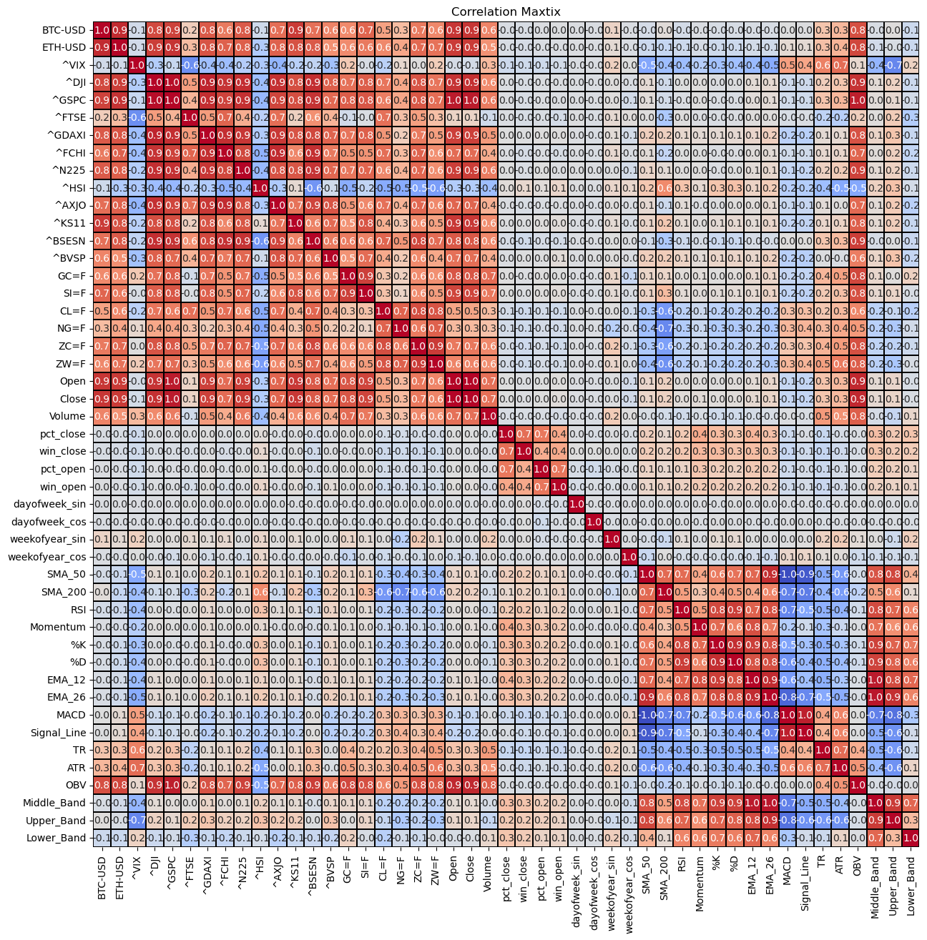

Slide 18
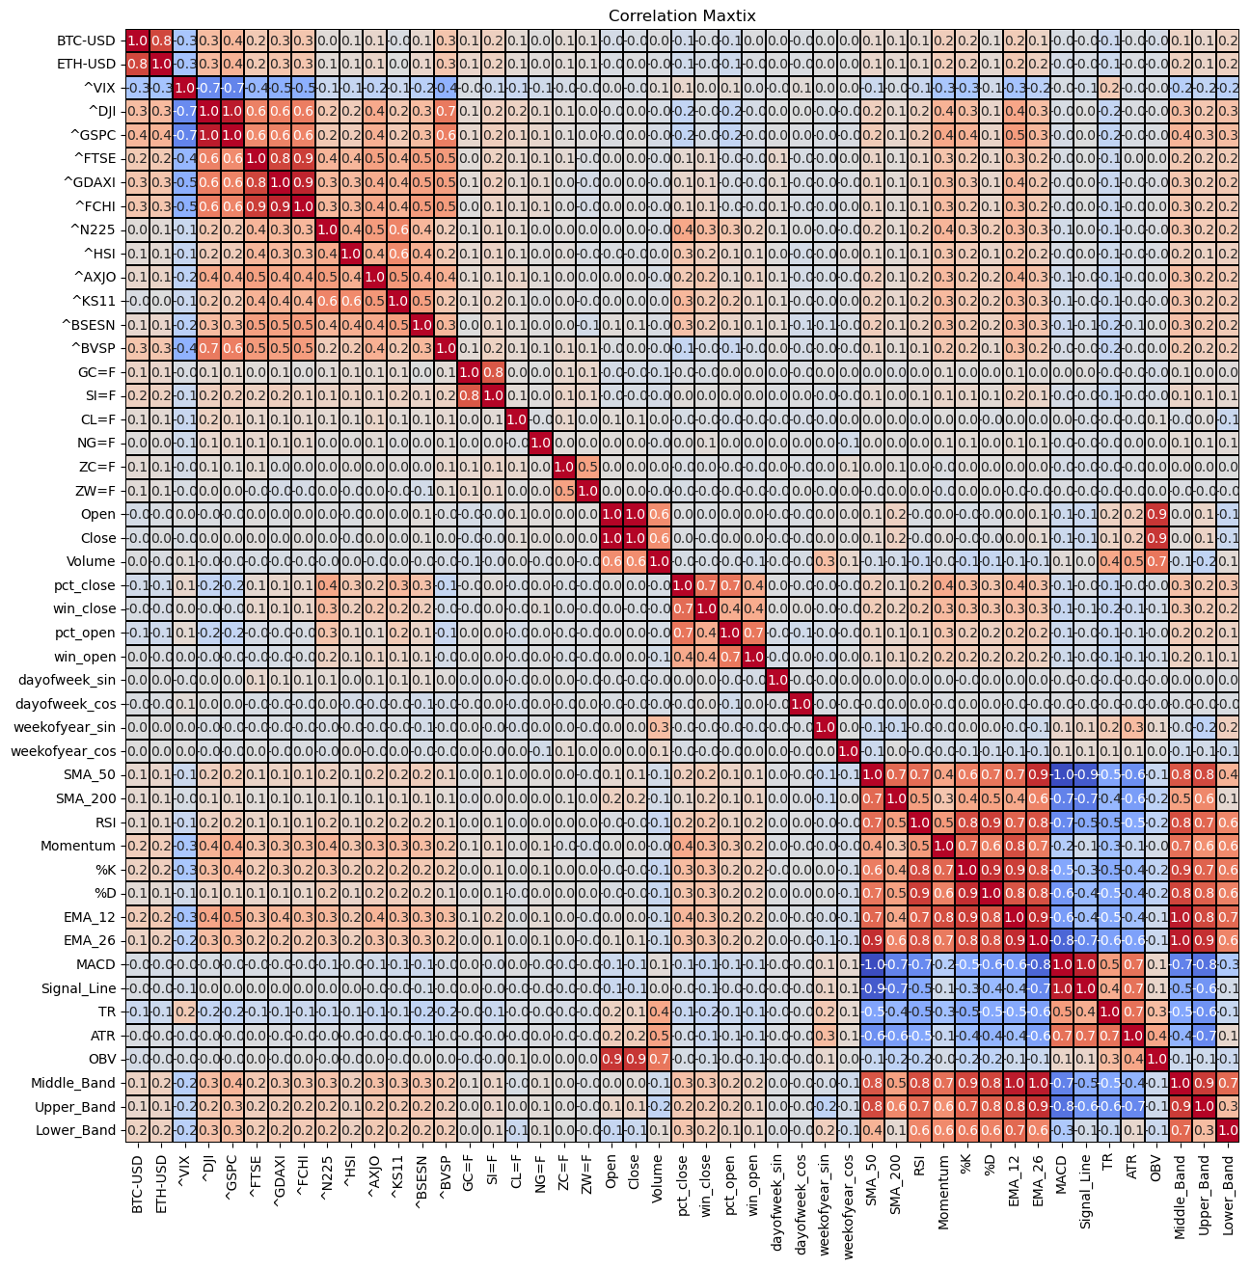

Slide 19
Scaling

Slide 20
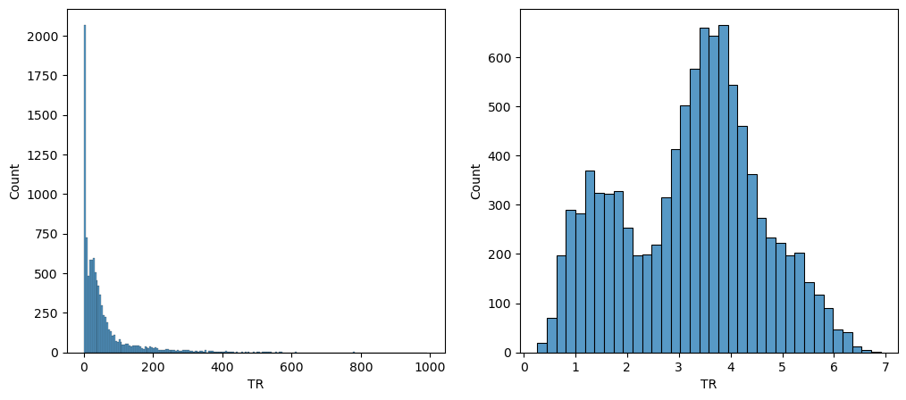
Log Scaling

Slide 21
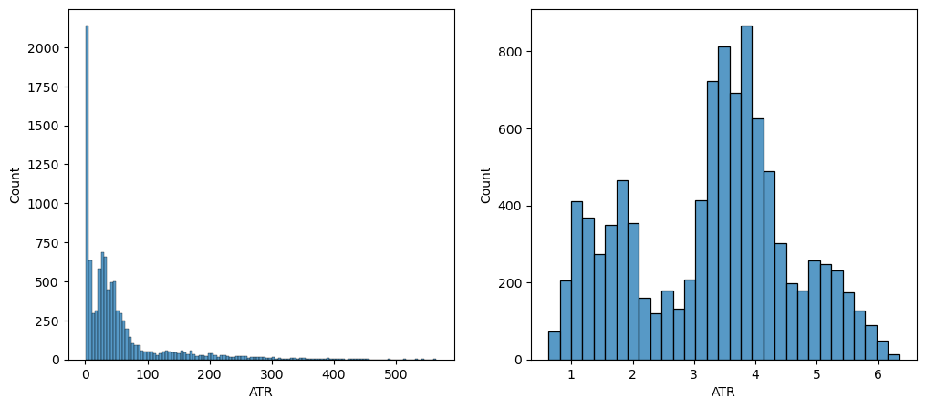
Log Scaling

Slide 22
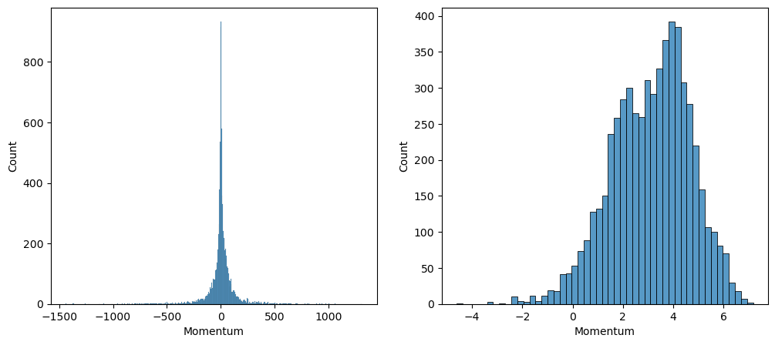
Log Scaling

Slide 23
Pipeline Overview

Slide 24
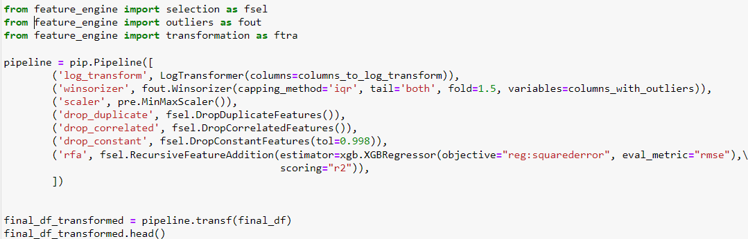

Slide 25
Modeling

Slide 26
Close Price Predictions

Slide 27
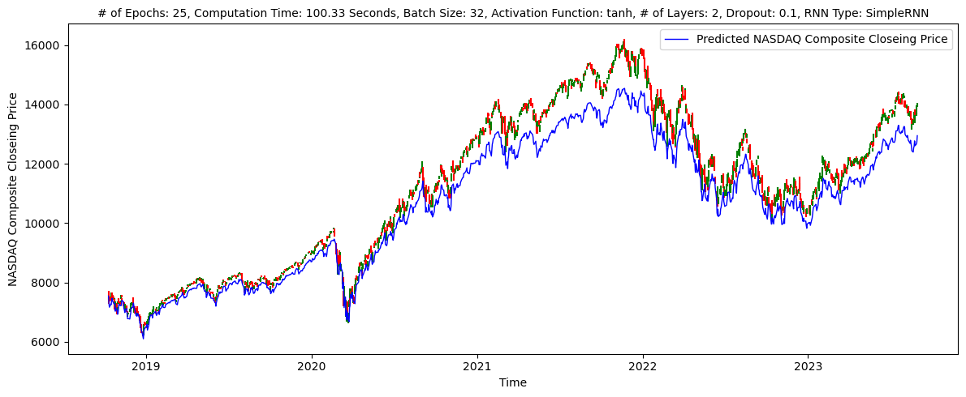
Regression model to predict NASDAQ Close Price using SimpleRNN - Only Close Price

Slide 28
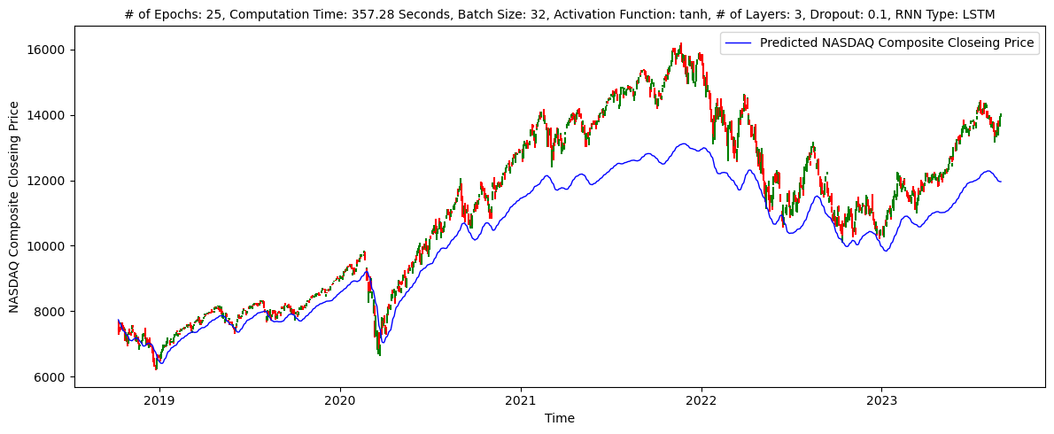
Regression model to predict NASDAQ Close Price using LSTM - Only Close Price

Slide 29
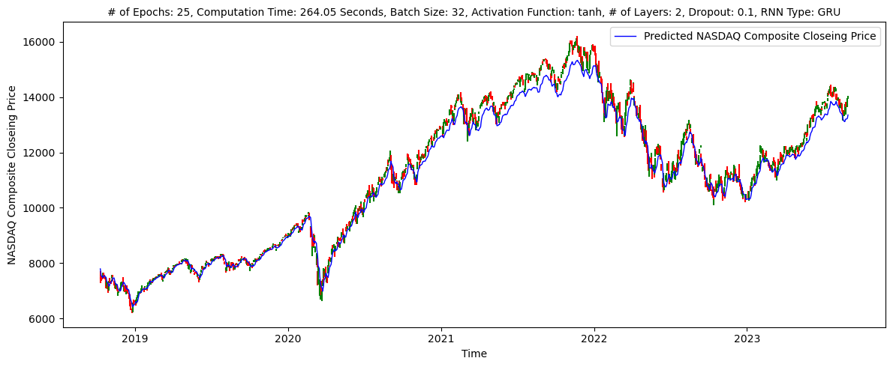
Regression model to predict NASDAQ Close Price using GRU - Only Close Price

Slide 30
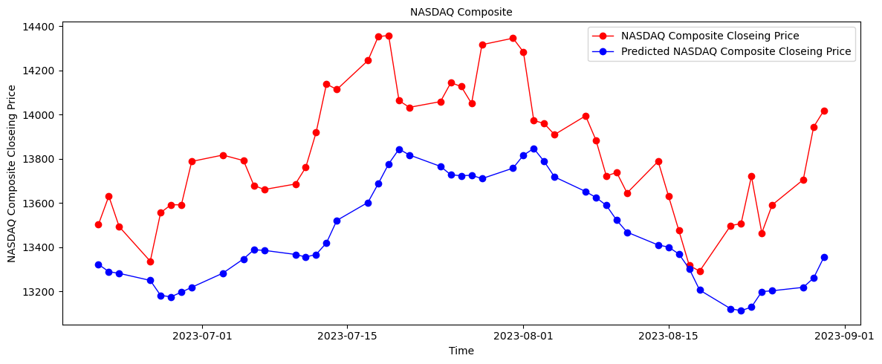
Let’s take a closer look

Slide 31
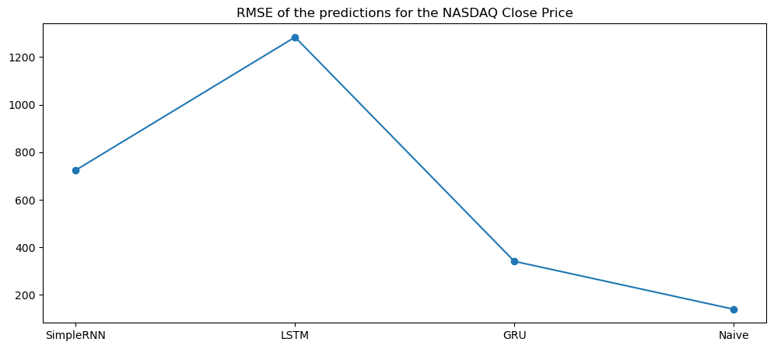
RNN Models Outcomes

Slide 32
Is RMSE a Good Indicator for Measuring the Success of Our Models?
The objective of this project is to generate profits through buying and selling stocks based on the predictions of statistical models. Up to this point, our focus has been on predicting the exact closing prices for the next day. However, one might ask: Do we actually need to know the next day's exact closing price to make money? For example, if our model predicts a 1% increase in stock price for the next day and the stock actually goes up by 2%, the RMSE (Root Mean Square Error) would increase, even though we would have profited from the prediction. What truly harms us is when the model predicts an increase and the stock price actually declines.

Slide 33
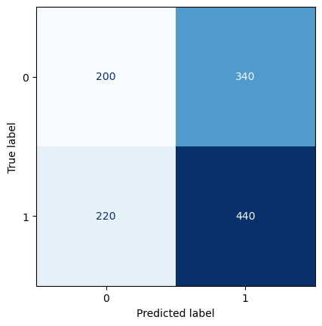
LSTM Regression Results in a Confusion Matrix

Slide 34
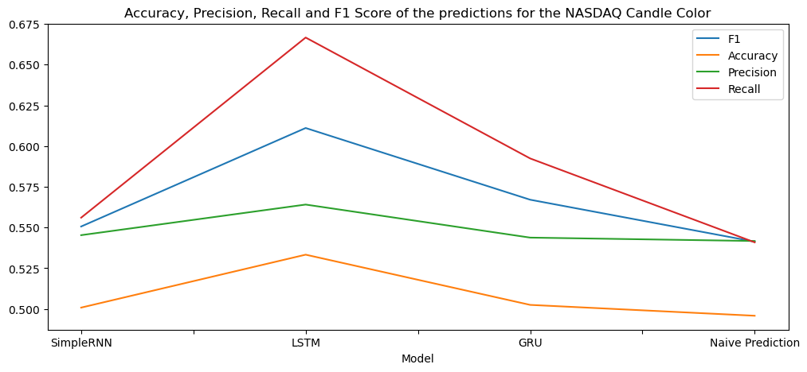
Candle Color Prediction Using the Regression Results

Slide 35
Candle Color Predictions

Slide 36
Models Used for Predictions
RNN Models – Only Close Price
SimpleRNN
LSTM
GRU
Machine Learning Models
XGBoost – Technical Indicators, Indices and Feature Engine

Slide 37
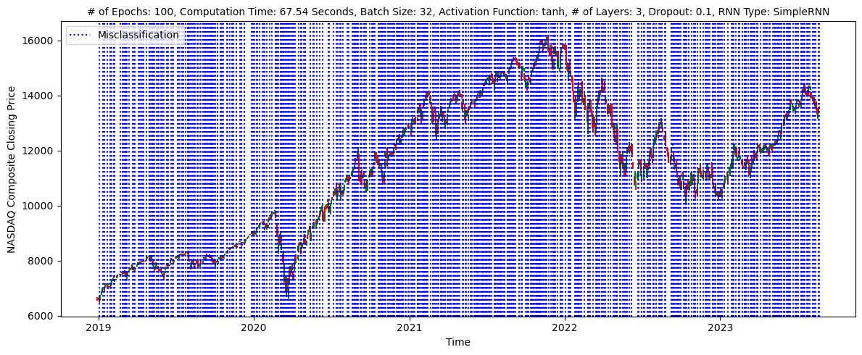
Classification model to predict NASDAQ Close Price using SimpleRNN

Slide 38

Classification model to predict NASDAQ Close Price using LSTM

Slide 39
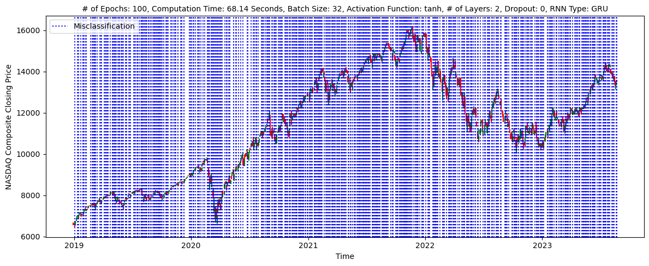
Classification model to predict NASDAQ Close Price using GRU

Slide 40
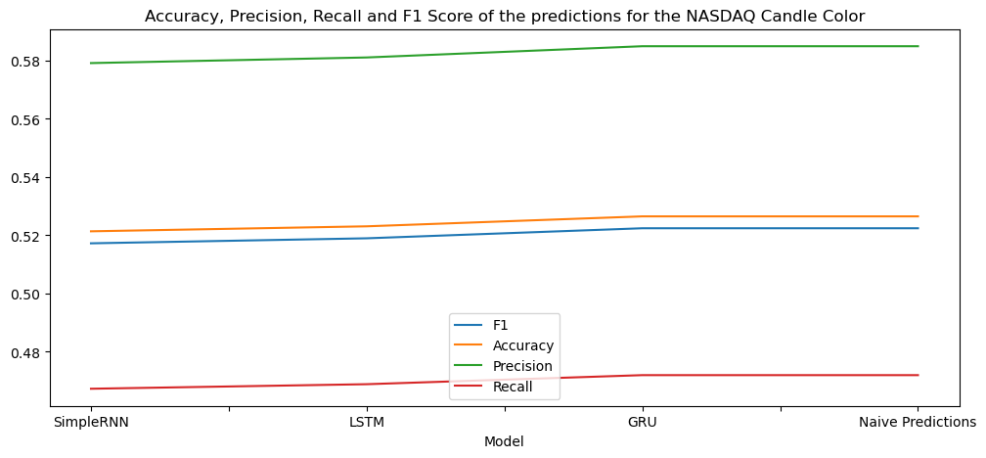
RNN Models Outcomes

Slide 41
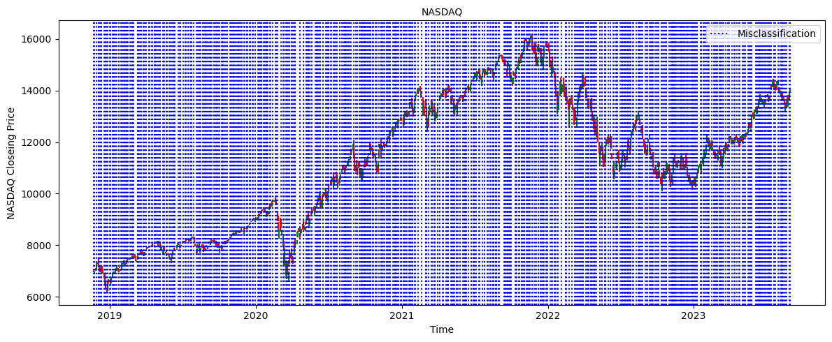
Predicting NASDAQ Close Price with XGBoost using Only Technical Indicators

Slide 42
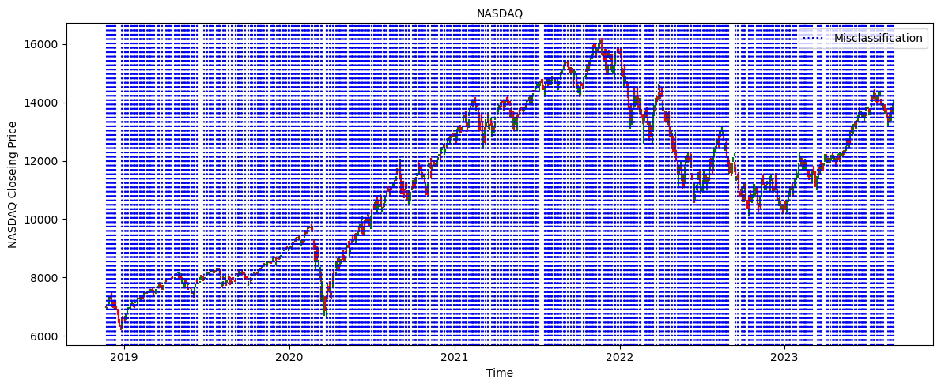
Predicting NASDAQ Close Price with XGBoost using Technical Indicators and Other Indices

Slide 43
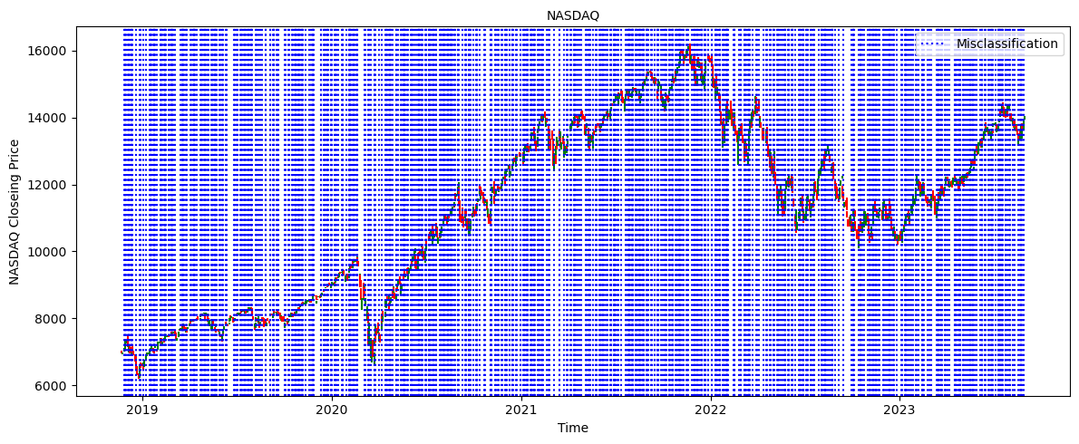
Predicting NASDAQ Close Price with XGBoost using Technical indicators, Other indices and Feature Engine

Slide 44
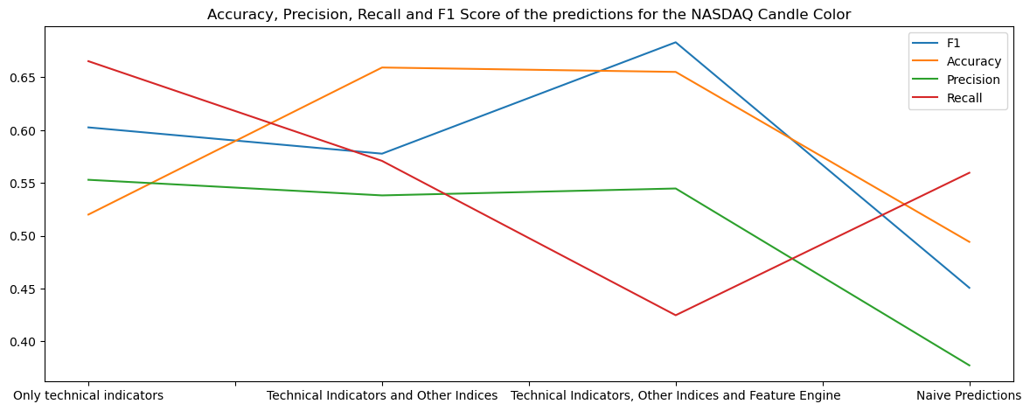
XGBoost Models Outcomes

Slide 45
Are Accuracy, Precision, Recall, and F1 Score Good Indicators for Measuring the Success of Our Models?¶
Should our primary focus be on predicting the color of stock candles? A candle's color represents whether the stock experienced a positive or negative percentage change. But what if our predictive criteria are met during the trading day, before the candle's final color is established?

Slide 46
Let’s revisit the primary goals of this project:
Avoid losing money.
Generate profits.

Slide 47
Percentage Change Predictions Using RNN Models

Slide 48
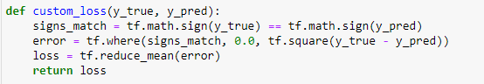
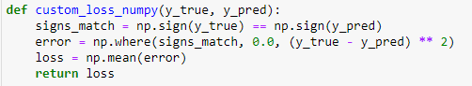
Custom Loss Functions

Slide 49
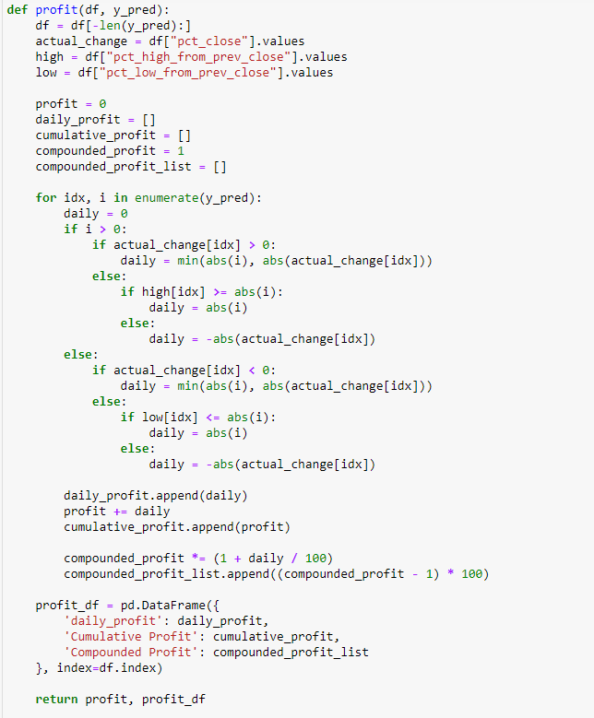
Profit Estimation

Slide 50
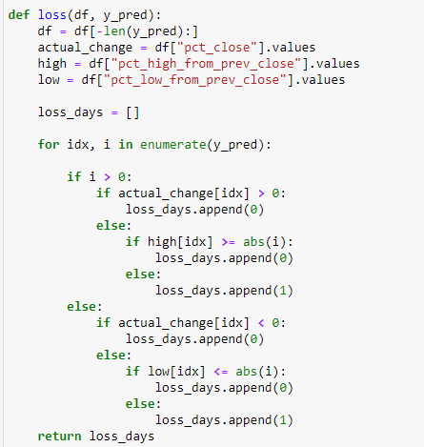
Visualizing Loss Days

Slide 51
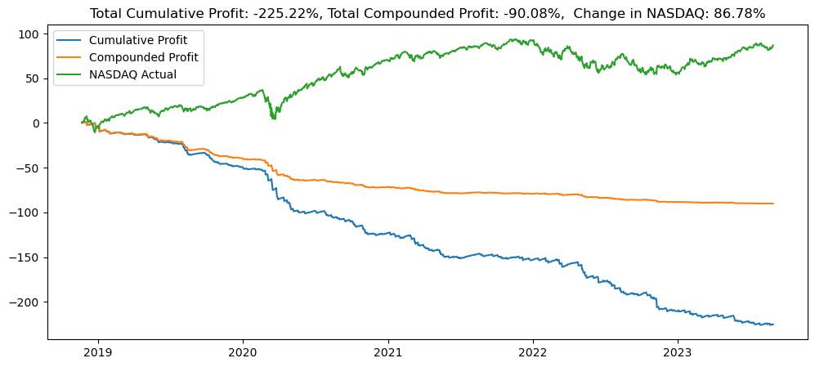
Profit With SimpleRNN Without Custom Loss Function

Slide 52
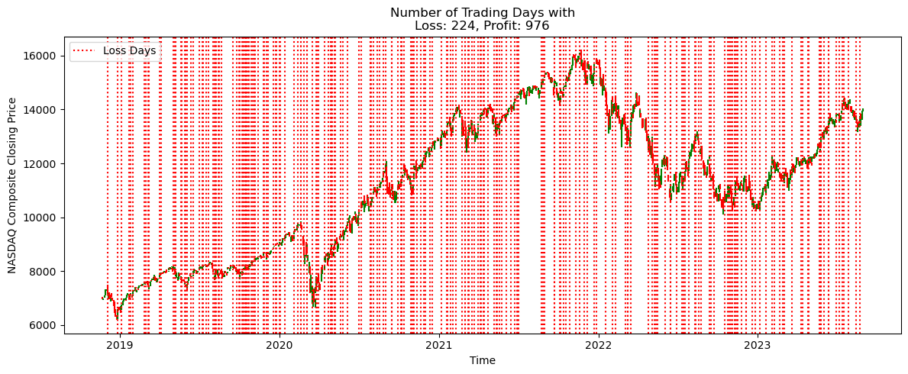
Loss Days With SimpleRNN Without Custom Loss Function

Slide 53
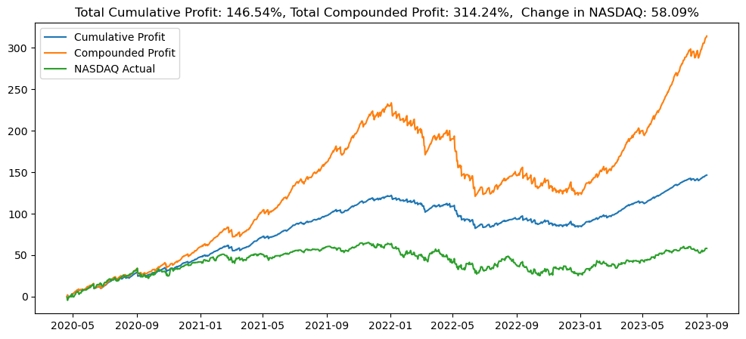
Profit With SimpleRNN With Custom Loss Function

Slide 54
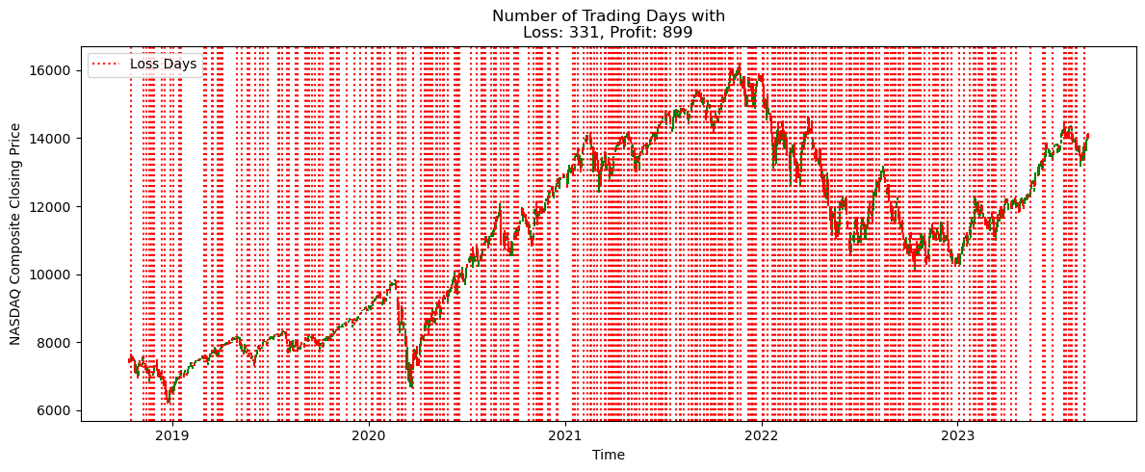
Loss Days With SimpleRNN With Custom Loss Function

Slide 55
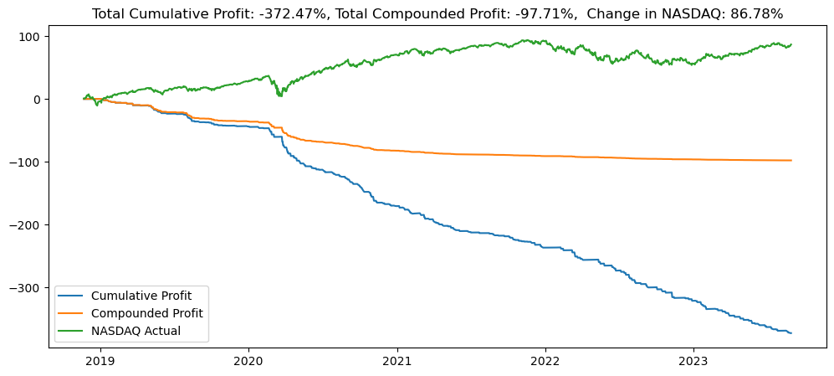
Profit With LSTM Without Custom Loss Function

Slide 56
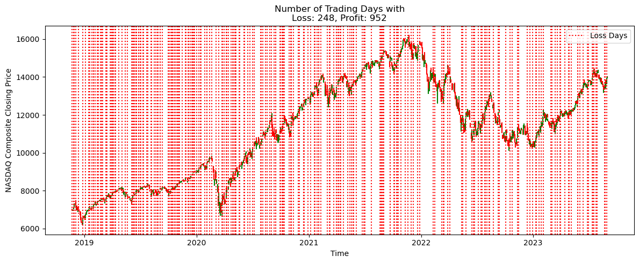
Loss Days With LSTM Without Custom Loss Function

Slide 57
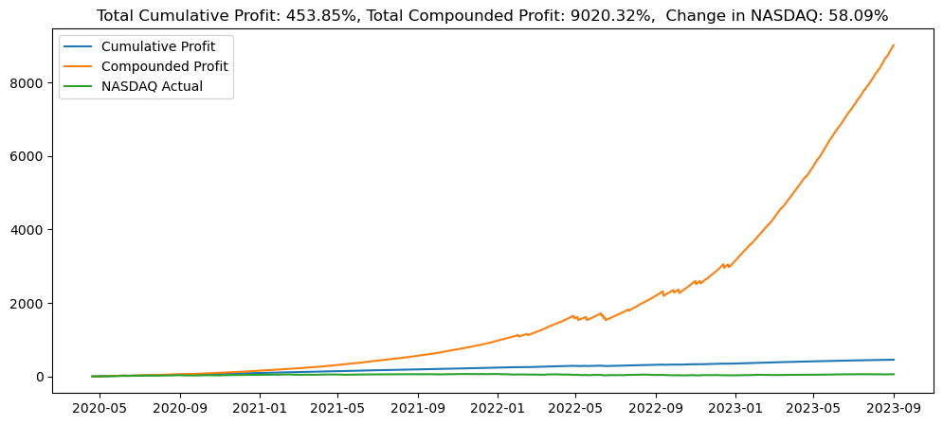
Profit With LSTM With Custom Loss Function

Slide 58
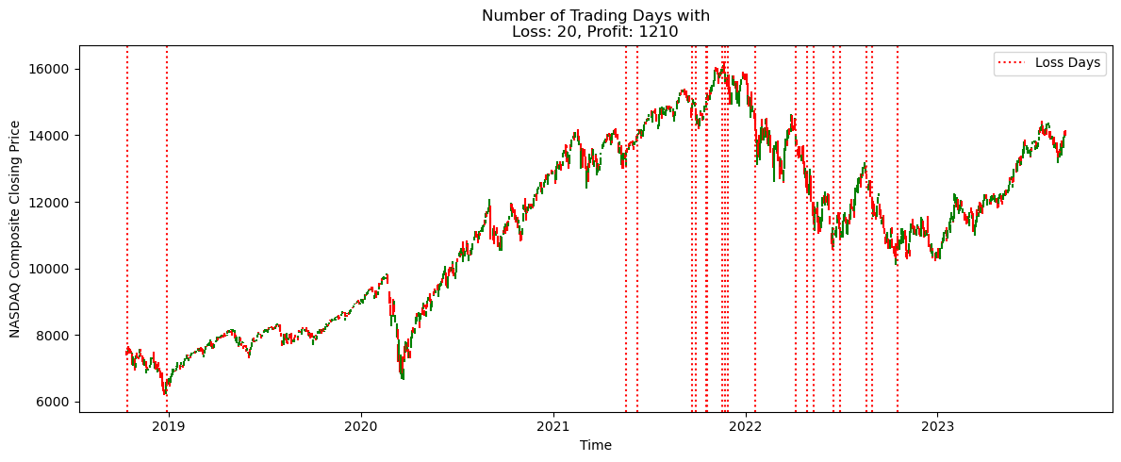
Loss Days With GRU With Custom Loss Function

Slide 59
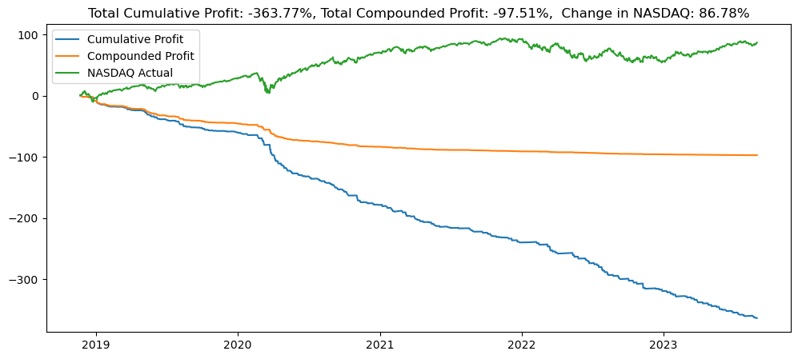
Profit With GRU Without Custom Loss Function

Slide 60

Loss Days With GRU Without Custom Loss Function

Slide 61
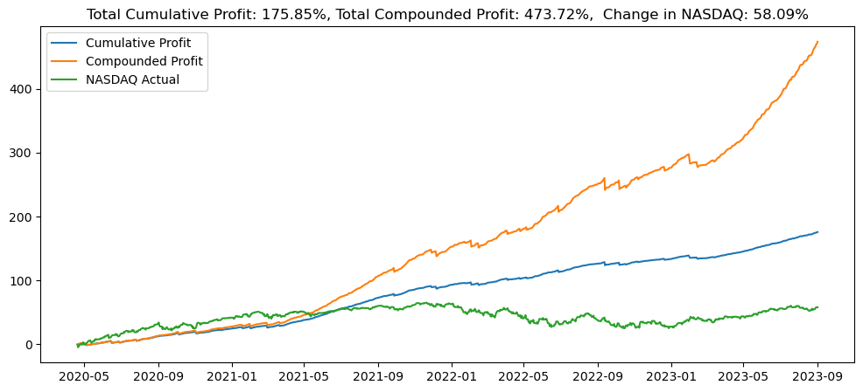
Profit With GRU With Custom Loss Function

Slide 62
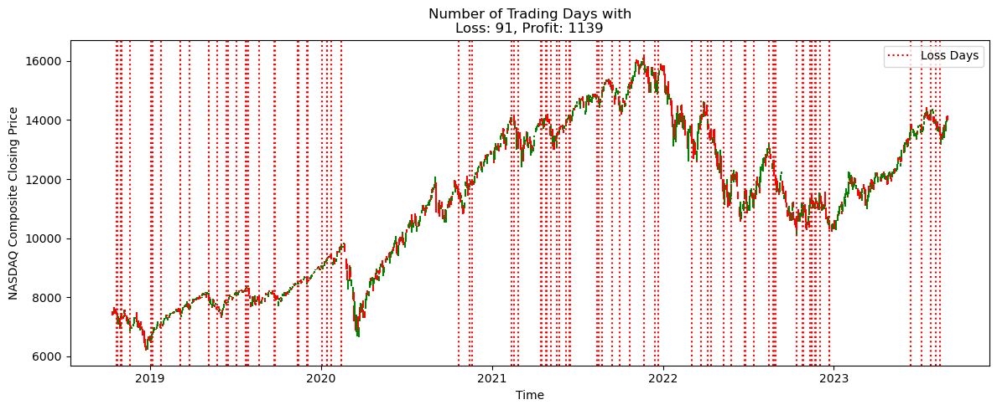
Loss Days With GRU With Custom Loss Function

Slide 63
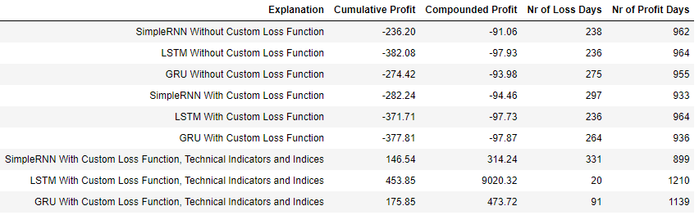
Results of RNN Models

Slide 64
Percentage Change Predictions Using Machine Learning Models

Slide 65
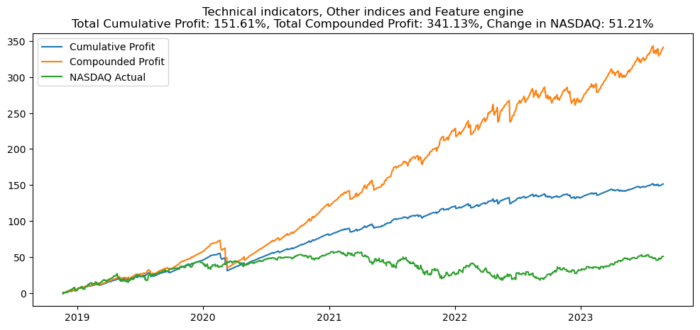
Profit With XGBoost Without Custom Loss Function

Slide 66
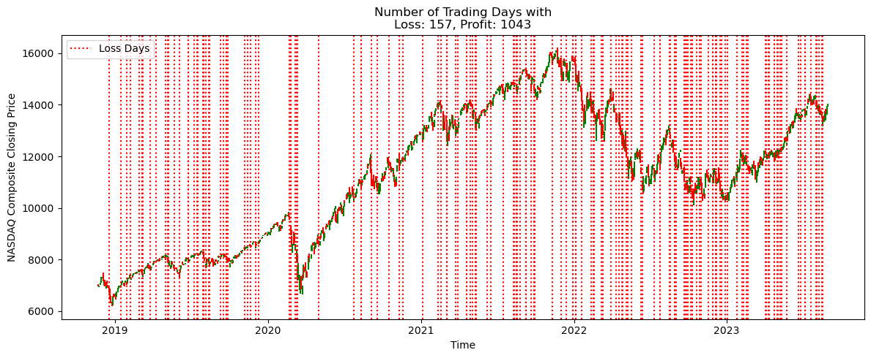
Loss Days With XGBoost Without Custom Loss Function

Slide 67
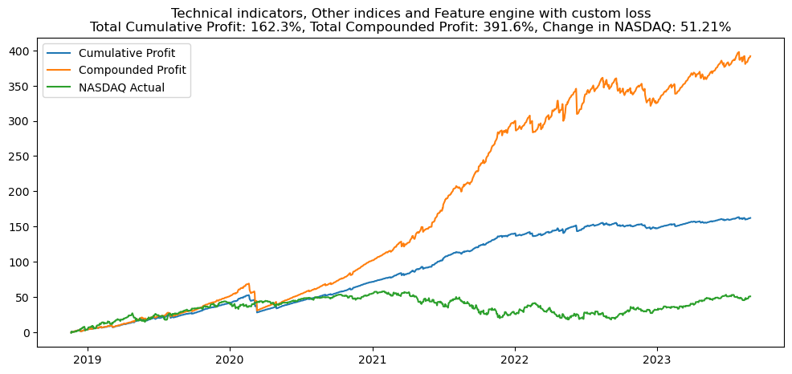
Profit With XGBoost With Custom Loss Function

Slide 68
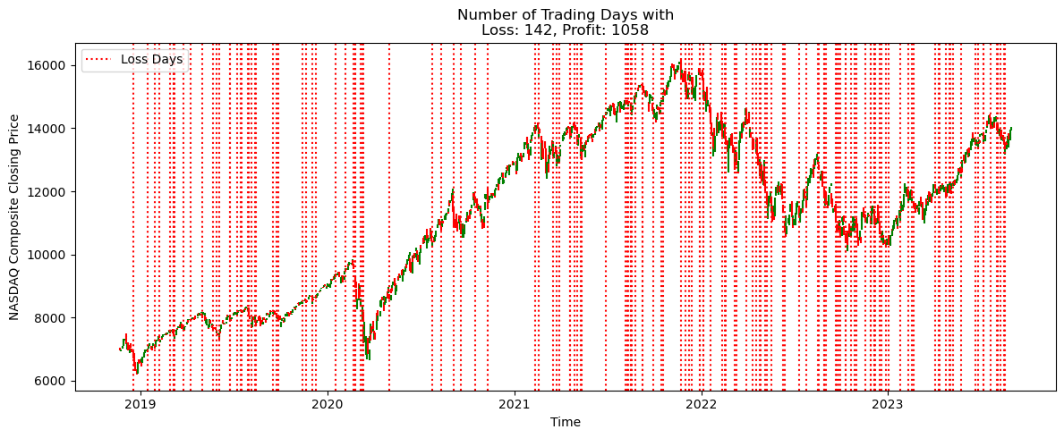
Loss Days With XGBoost With Custom Loss Function

Slide 69

Custom Loss Function to Maximize Profit

Slide 70

Profit with XGBoost Using the Second Custom Loss Function

Slide 71

Loss Days with XGBoost Using The Second Custom Loss Function

Slide 72

Results of XGBoost Models

Slide 73
Thank You For Listening!

